Slide 1
Fundamentals of Machine Learning

Slide 2
What is Machine Learning?

Slide 3
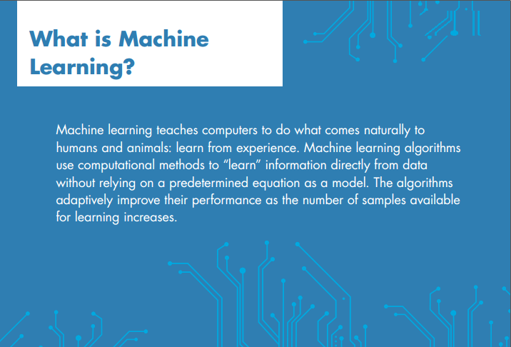

Slide 4

HELLO!
I am Sajid !
I am here because I love to give presentations.
You can find me at sajid@eveati.com

Slide 5
Examples?

Slide 6



Examples

Slide 7

Examples
A new way forward in mobility

Slide 8
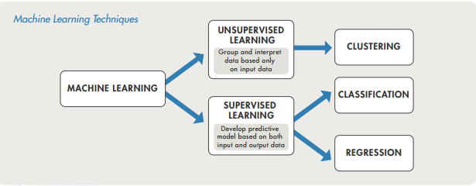
How Machine Learning Works

Slide 9
How Machine Learning Works
Predicts Discrete Responses
CLASSIFICATION

Slide 10
How Machine Learning Works?
Predicts Continuous Responses
REGRESSION

Slide 11
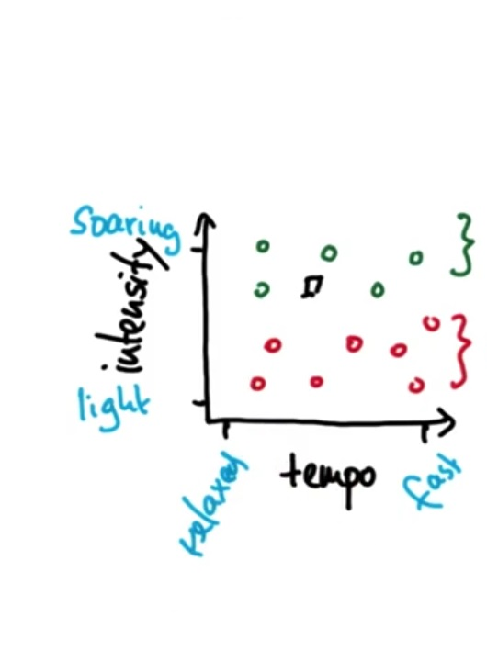
Features and Labels
REGRESSION

Slide 12
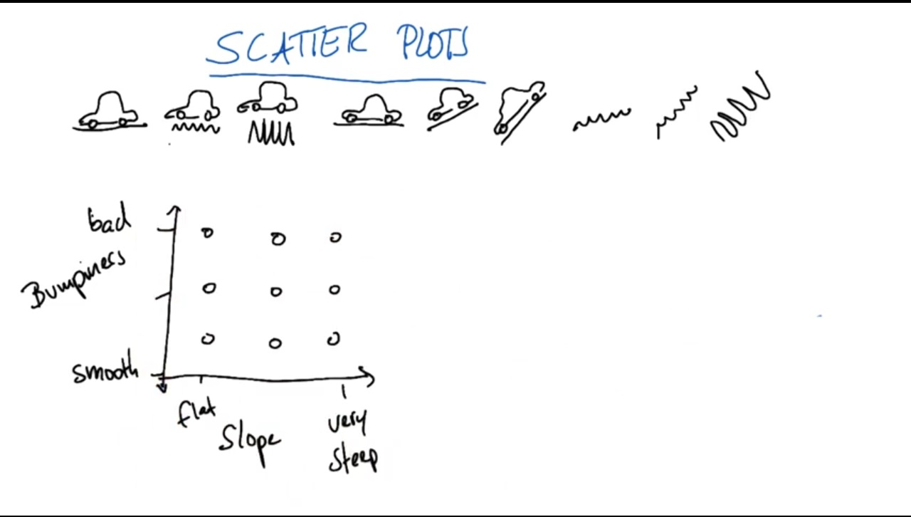
Example…
REGRESSION

Slide 13
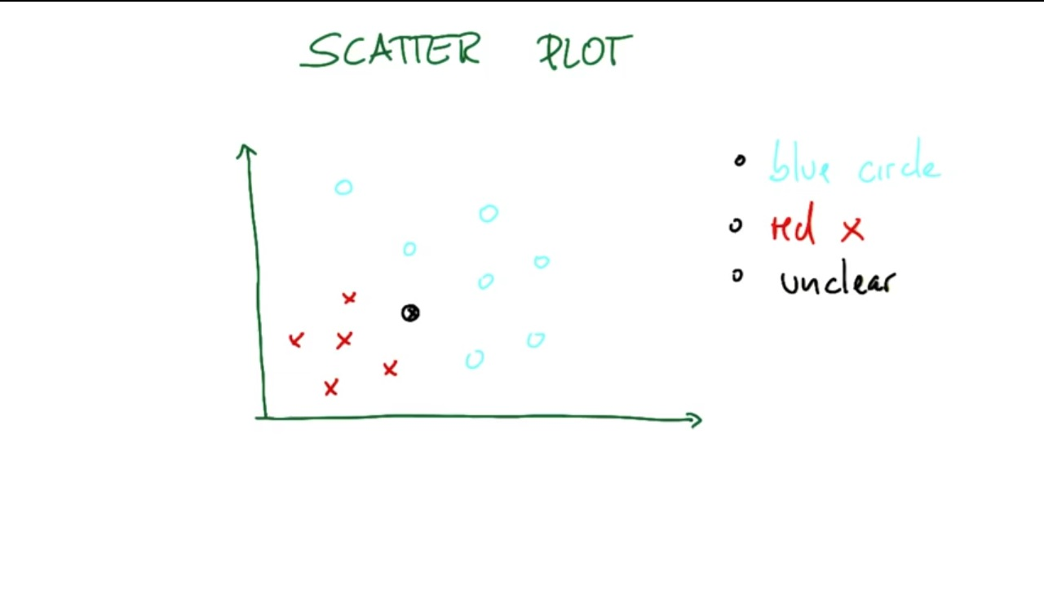
Example…
REGRESSION

Slide 14
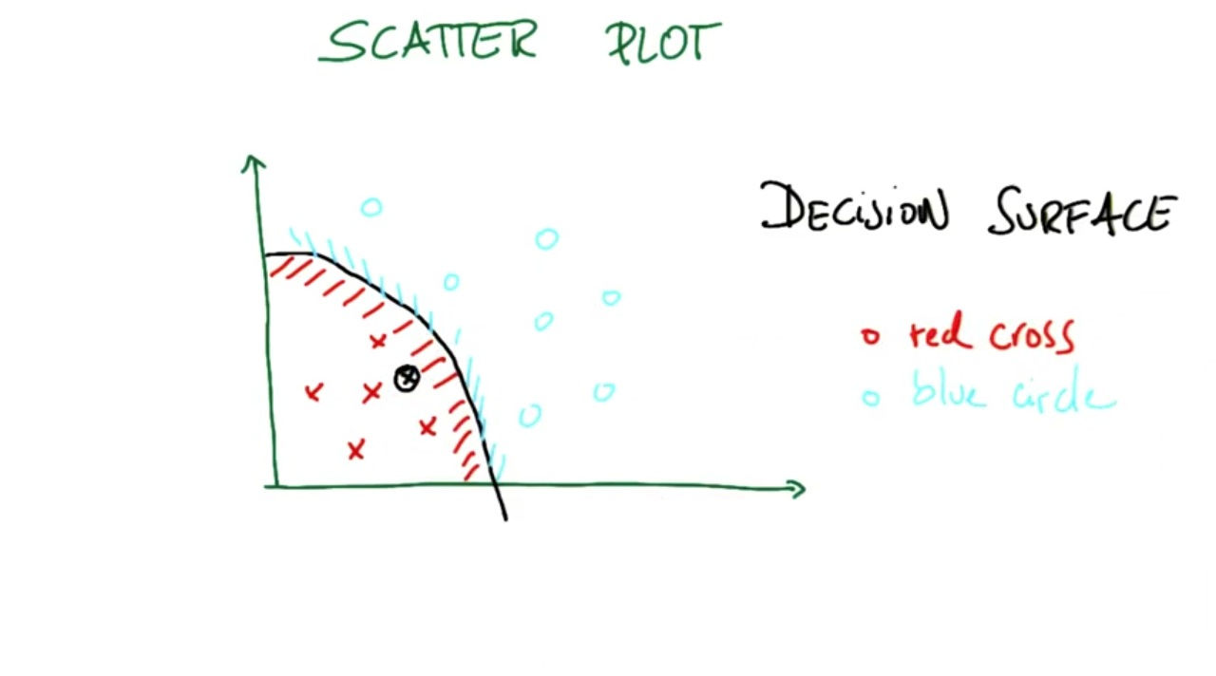
Example…
REGRESSION

Slide 15
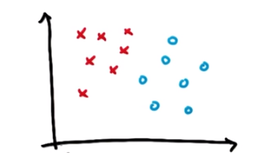
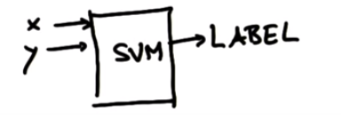
SVM…
Clustering hidden patterns in the data

Slide 16
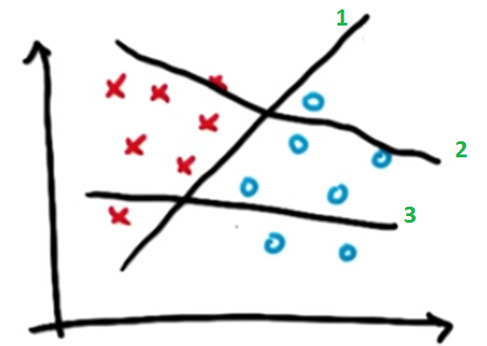
Which is the best separating hyperplane?

Slide 17
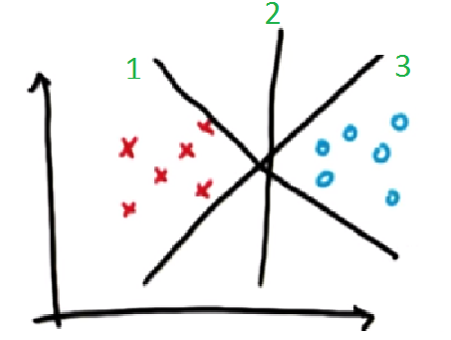
What about this one?

Slide 18
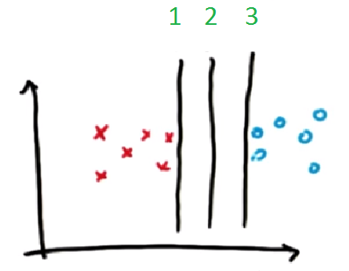
What about this one?

Slide 19
What about this one?

Slide 20
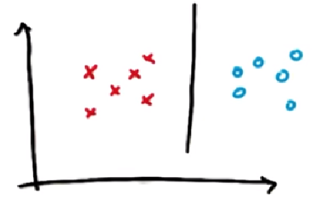
What does this line do that others don’t do?

Slide 21
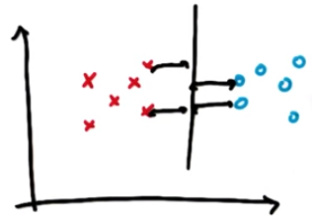
It maximizes the distance to nearest point of both the classes.

Slide 22
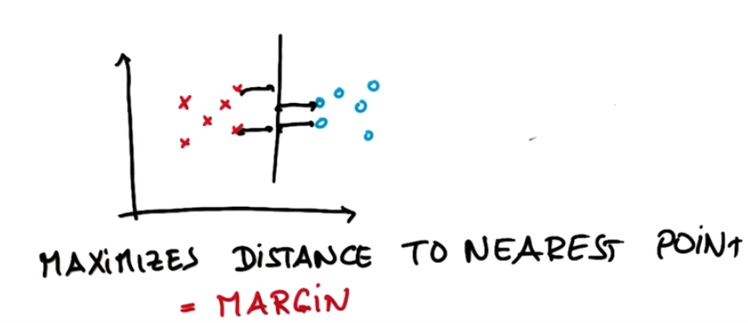
Margin

Slide 23
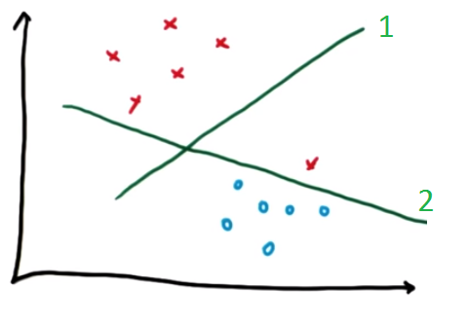
Which line do you think that SVM will construct?

Slide 24
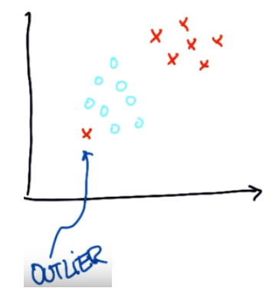
Its actually a rebel that doesn’t follow the trend of the rest of its class samples.

Slide 25
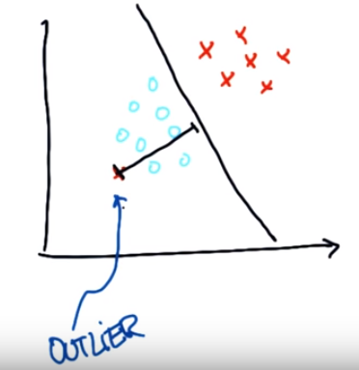
Outlier…

Slide 26
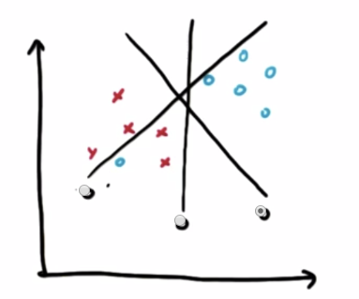
Which hyperplane do you think SVM will construct?

Slide 27
SVM
Coding Examples

Slide 28
Linearly Separable Data
Muffins-Cupcakes example

Slide 29
LinearSVC
import pandas as pd
import numpy as np
from sklearn.svm import LinearSVC
import matplotlib.pyplot as plt
recipes = pd.read_csv('recipes_muffins_cupcakes.csv')
ingredients = recipes[['Flour','Sugar']].as_matrix()
type_label = np.where(recipes['Type']=='Muffin',1, 0)
model = LinearSVC(random_state=0)
model.fit(ingredients, type_label)
# limits for plots
xx, yy = np.meshgrid(np.linspace(30, 60), np.linspace(0, 35))
# plot the decision function for each datapoint on the grid
Z = model.decision_function(np.c_[xx.ravel(), yy.ravel()])
Z = Z.reshape(xx.shape)
plt.scatter(ingredients[:, 0], ingredients[:, 1],c=type_label, cmap=plt.cm.Paired)
contours = plt.contour(xx, yy, Z, levels=[0])
plt.show()

Slide 30
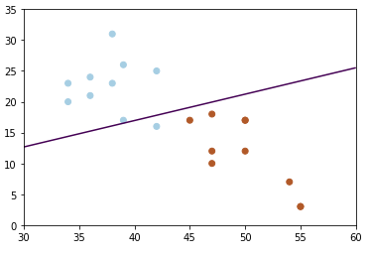

Slide 31
Training and testing
total_samples= len(recipes)
num_trn_samples= round(0.7* total_samples)
X_trn= ingredients[0:num_trn_samples]
Y_trn= type_label[0:num_trn_samples]
X_tst= ingredients[num_trn_samples:]
Y_tst= type_label[num_trn_samples:]
model=LinearSVC(random_state=0)
model = model.fit(X_trn, Y_trn)
predicted_labels = model.predict(X_tst)

Slide 32
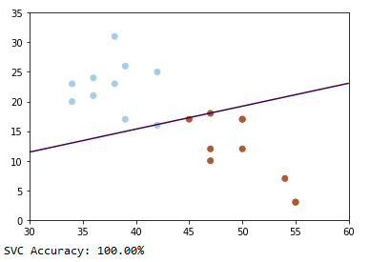
Accuracy
from sklearn.metrics import accuracy_score
print("SVC Accuracy: {0:.2%}".format(accuracy_score(predicted_labels, Y_tst)))

Slide 33
Accuracy vs data size
Test with different data sizes and analyze difference in accuracy.

Slide 34
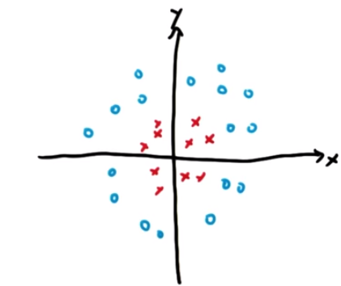
Question: Do you think this data is linearly separable? Do you think this data can be modelled by a linear SVM?

Slide 35
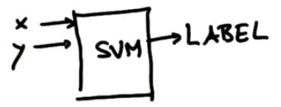
…
The data is not really linearly separable…..but it can be modelled by a linear SVM.
That’s how…………

Slide 36
…
If we show the exact same data in a new plot with z and x, omitting y, we get………….

Slide 37
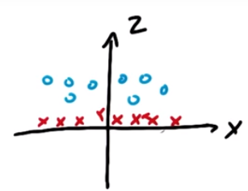

Slide 38
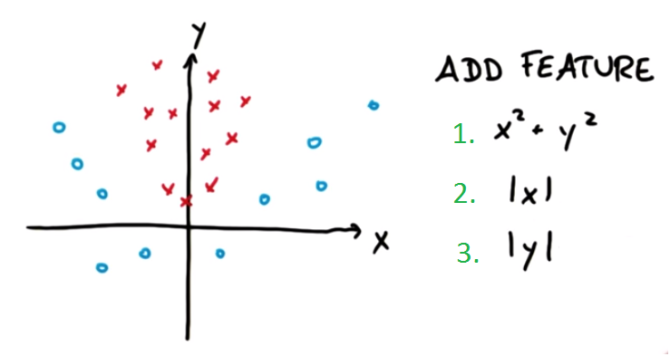
Which feature would you add to the figure below to get linearly separable data?

Slide 39
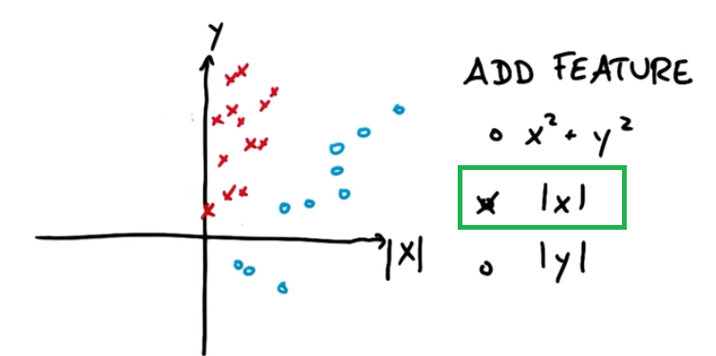
Question

Slide 40
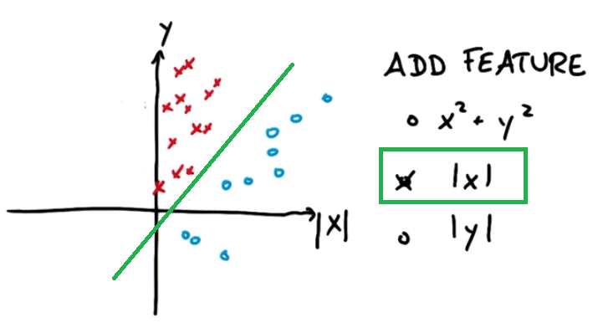

Slide 41
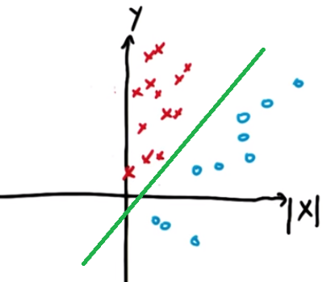
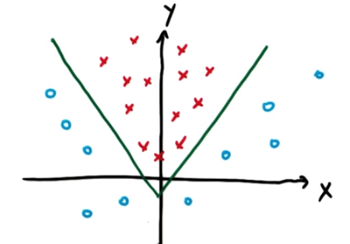
What did this linear separation look like in the original graph? Non linear.

Slide 42
Non Linear Data

Slide 43
How to deal with non-linear data
1. Transform every two-dimensional vector into a three-dimensional or higher vector using the 2. Train the SVMs using the 3D dataset.

Slide 44
Kernels
Why use kernels?
Make non-separable problem separable.
Map data into better representational space

Slide 45
Common kernels
Linear K(x,z’)=x.z’
Polynomial K(x,z) = (c+x^{T}z)^{d}
RBF K(x,z) =exp (-γ||x-z’||)^{d}

Slide 46
Linear SVM
import pandas as pd
import numpy as np
from sklearn import svm
import matplotlib.pyplot as plt
recipes = pd.read_csv('recipes_muffins_cupcakes.csv')
ingredients = recipes[['Flour','Sugar']].as_matrix()
type_label = np.where(recipes['Type']=='Muffin',1, 0)
model = svm.SVC(kernel='linear', C=1e3, degree=10) #try with degree 1, 10
model.fit(ingredients, type_label)
xx, yy = np.meshgrid(np.linspace(30, 60), np.linspace(0, 35))
# plot the decision function for each datapoint on the grid
Z = model.decision_function(np.c_[xx.ravel(), yy.ravel()])
Z = Z.reshape(xx.shape)
plt.scatter(ingredients[:, 0], ingredients[:, 1],c=type_label, cmap=plt.cm.Paired)
contours = plt.contour(xx, yy, Z, levels=[0])
plt.show()

Slide 47
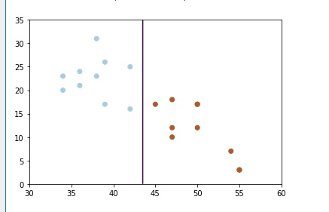
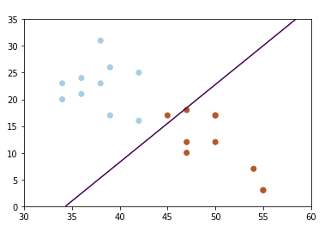
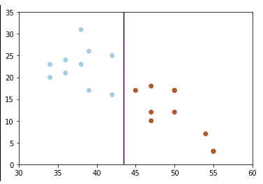
C=1e3, degree=10
C=1e-3, degree=10
C=1e3, degree=1e5

Slide 48
Training and Testing
total_samples= len(recipes)
num_trn_samples= round(0.7* total_samples)
X_trn= ingredients[0:num_trn_samples]
Y_trn= type_label[0:num_trn_samples]
X_tst= ingredients[num_trn_samples:]
Y_tst= type_label[num_trn_samples:]
model= svm.SVC(kernel='linear', C=1.0, gamma= 1e10) model = model.fit(X_trn, Y_trn)
predicted_labels = model.predict(X_tst)
from sklearn.metrics import accuracy_score
print("SVC Accuracy: {0:.2%}".format(accuracy_score(predicted_labels, Y_tst)))

Slide 49
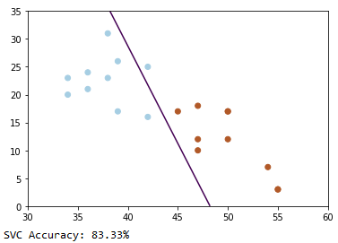
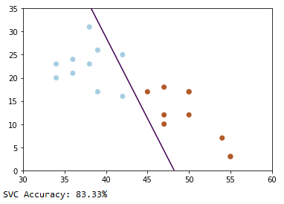
Accuracy
C=1, Gamma=1e-10 C=1,Gamma=1e10

Slide 50
Conclusion
A small c will give a wider margin, at the cost of some misclassifications. • A huge will give the hard margin classifier and tolerates zero constraint violation. • The key is to find the value of such that noisy data does not impact the solution too much. Degree and gamma has no effect on linear SVM.

Slide 51
Iris Flower Example

Slide 52
Polynomial Kernel
model= svm.SVC(kernel='poly', C=10,degree=1)

Slide 53
iris = datasets.load_iris()
X = iris.data[:, :2] # we only take the first two features.
Y = iris.target
total_samples= len(Y)
trn_samples= round(0.7* total_samples)
#
X_trn= X[0:trn_samples];Y_trn= Y[0:trn_samples]#
X_tst= X[trn_samples:];Y_tst= Y[trn_samples:]
# Plot resulting Support Vector boundaries with original data
# Create fake input data for prediction that we will use for plotting
# create a mesh to plot in
x_min, x_max = X[:, 0].min() - 1, X[:, 0].max() + 1
y_min, y_max = X[:, 1].min() - 1, X[:, 1].max() + 1
h = (x_max / x_min)/100
xx, yy = np.meshgrid(np.arange(x_min, x_max, h),
np.arange(y_min, y_max, h));X_plot = np.c_[xx.ravel(), yy.ravel()]
# Create the SVC model object
svm_model_linear= svm.SVC(kernel='linear', C=10, gamma= 'auto') #gamma never affects linear kernel
svc = svm_model_linear.fit(X_trn, Y_trn)
Z = svc.predict(X_plot);Z = Z.reshape(xx.shape)
plt.figure(figsize=(15, 5));plt.subplot(121)
plt.contourf(xx, yy, Z, cmap=plt.cm.tab10, alpha=0.3)
plt.scatter(X_trn[:, 0], X_trn[:, 1], c=Y_trn, cmap=plt.cm.Set1)
plt.xlabel('Sepal length');plt.ylabel('Sepal width')
plt.xlim(xx.min(), xx.max());plt.title('SVC with linear kernel')
svm_model_poly= svm.SVC(kernel='poly', C= 10, degree=1)
svc = svm_model_poly.fit(X_trn, Y_trn)
Z = svc.predict(X_plot);Z = Z.reshape(xx.shape)
plt.subplot(122)
plt.contourf(xx, yy, Z, cmap=plt.cm.tab10, alpha=0.3)
plt.scatter(X_trn[:, 0], X_trn[:, 1], c=Y_trn, cmap=plt.cm.Set1)
plt.xlabel('Sepal length');plt.ylabel('Sepal width')
plt.xlim(xx.min(), xx.max());plt.title('SVC with Polynomial kernel of degree 1 ')
plt.show()

Slide 54
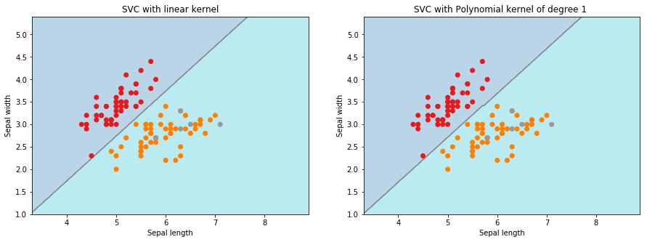
SVC Accuracy for linear kernel is: 0.00% SVC Accuracy for Polynomial kernel is: 4.44%

Slide 55
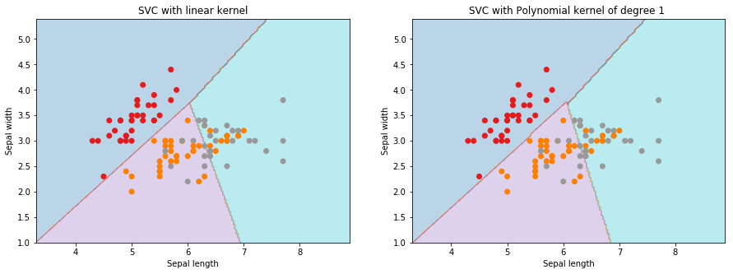
X_trn, X_tst, Y_trn, Y_tst = train_test_split(X, Y, test_size = 0.3)
SVC Accuracy for linear kernel is: 77.78%
SVC Accuracy for Polynomial kernel is: 77.78%

Slide 56
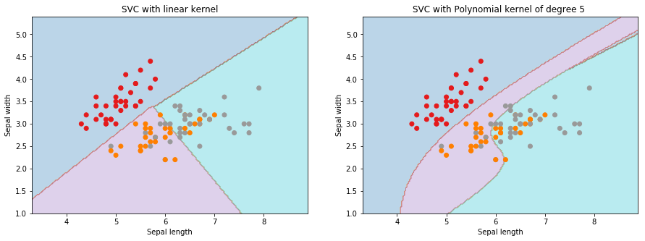
SVC Accuracy for linear kernel is: 77.78%
SVC Accuracy for Polynomial kernel is: 80.00%

Slide 57
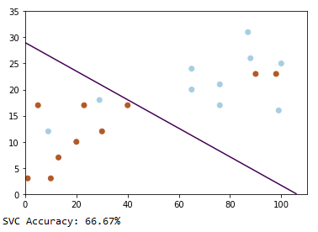
Affect of degree

Slide 58
RBF Kernel

Slide 60

THANKS!
Any questions?
You can find me at:
@username
user@mail.me

